Slide 1
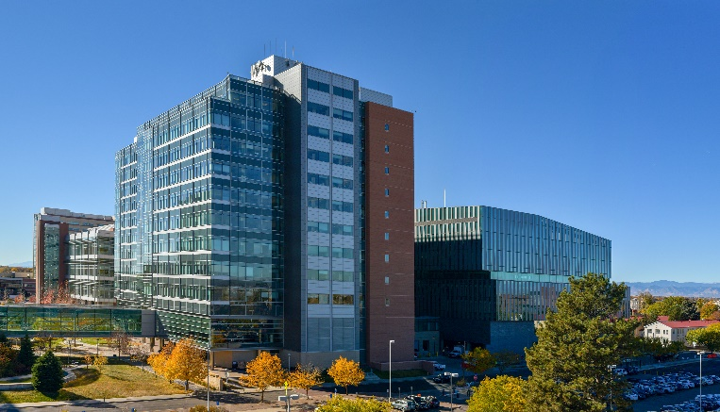
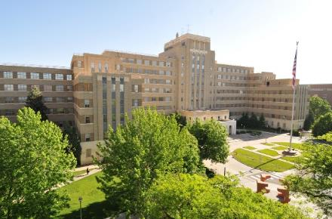
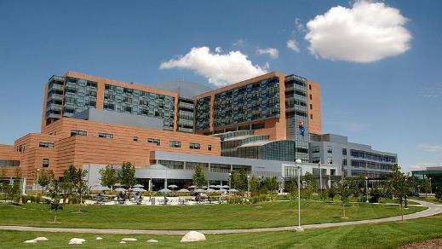
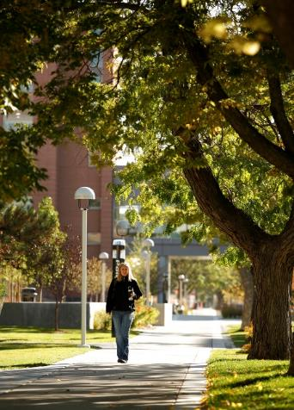
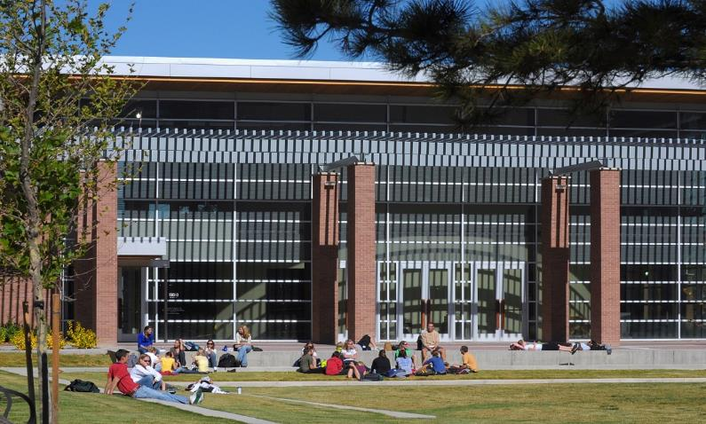
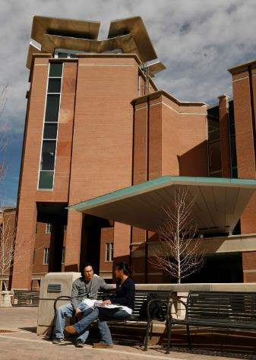
Sustainability & Resiliency on the
CU Anschutz Medical Campus
Facilities Management & Planning
April 24, 2024
Notes:
Intro of speakers and kickoff

Slide 2
Question What does sustainability mean to you?
What is Sustainability?
Notes:
Jay will lead this discussion
GHG emissions, electricity use, water, waste/recycle/compost, green transportation

Slide 3
Question What does sustainability mean to you?
What is Sustainability?
Unites States Environmental Protection Agency (EPA)
Sustainability is based on a simple principle: Everything that we need for our survival and well-being depends, either directly or indirectly, on our natural environment.
To pursue sustainability is to create and maintain the conditions under which humans and nature can exist in productive harmony to support present and future generations.
Notes:
Jay will lead this discussion
GHG emissions, electricity use, water, waste/recycle/compost, green transportation

Slide 4
Question What does resiliency mean to you?
What is Resiliency?
Notes:
Jay will lead this discussion
Reliability of utilities, electricity, water, etc.
Roads and transportation
CUP services, steam and chilled water
Hospital partners

Slide 5
Question What does resiliency mean to you?
What is Resiliency?
Resilience – the capacity to recover quickly from difficulties; toughness
While sustainability looks at how current generations can meet their needs without compromising that ability for future generations, resilience considers a system’s ability to prepare for threats, to absorb impacts, and to recover and adapt after disruptive events.
Notes:
Jay will lead this discussion
Reliability of utilities, electricity, water, etc.
Roads and transportation
CUP services, steam and chilled water
Hospital partners

Slide 6
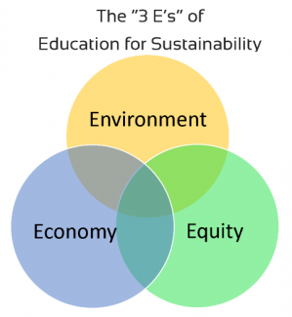
Greenhouse Gas Emissions Scopes
Scope 1: What We Burn – Natural Gas to make Steam, Fleet Vehicle Fuel
Scope 2: What We Buy – Electricity from Xcel
Scope 3: What We Don’t Control (Directly) –
Commuting
Business Travel
Purchasing/supply chain
Waste generation
Water Use
Colorado has requirements for addressing Scopes 1 & 2
The University of Colorado is committed to the long-term goal of carbon neutrality
Notes:
Jarrett

Slide 7
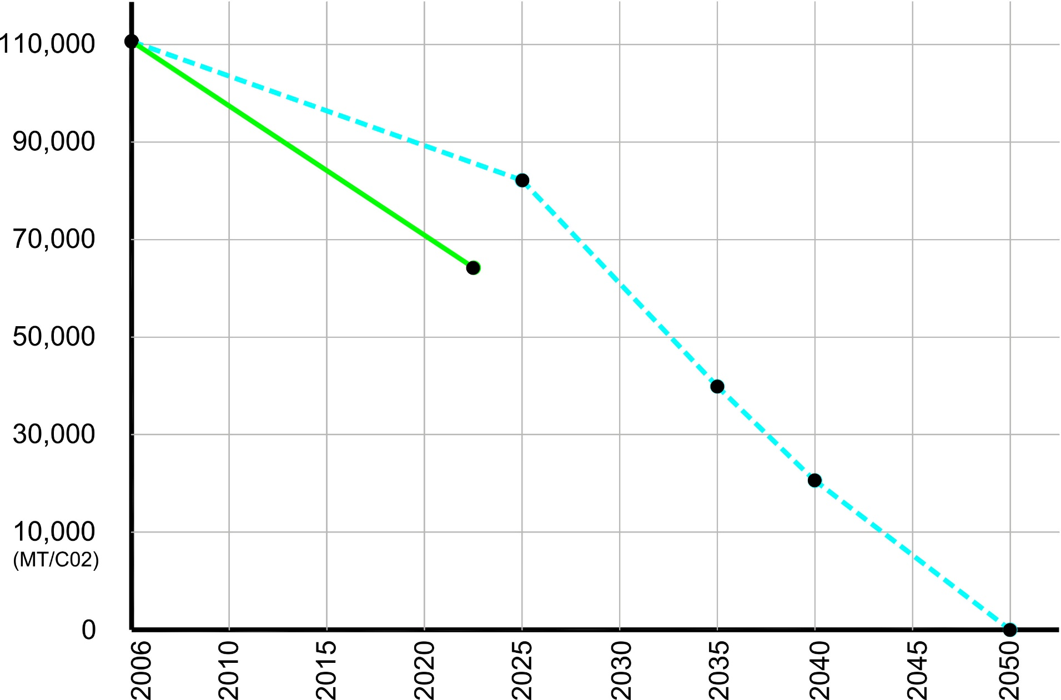
GHG Inventory & Accounting
ACTUAL
REQUIRED
Notes:
Jarrett

Slide 8
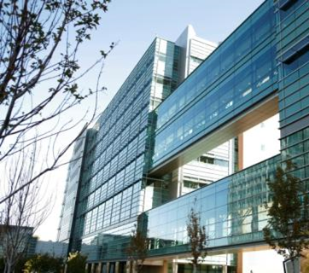
Lessons Learned
Research Complex 1
First Research Tower on Campus – Built before State Standards for High Performance Buildings
Value-Engineered During Construction
Energy Hog – Energy Use Intensity is 352 (2023)
Started Energy Conservation Measures (ECMs) in 2011
Spent over $11 Million – still doing work today to complete the full list of ECMs
Lesson Learned – Build Better First
Need for Long-term Planning – Physical & Financial
Notes:
Jarrett

Slide 9
Recent Colorado Legislation
HB19-1261(Climate Action Plan to Reduce Pollution – Established Clean Energy Plan requirements)
HB19-1260 (Building Energy Codes)
HB21-1286 (Energy Performance for Buildings)
SB21-264 Reduce Natural Gas Utility Emissions (Clean Heat Plan)
HB22-1362 (Energy-Efficient Building Codes)
SB22-051 (Heat Pumps and Building materials)
HB22-1218 (EV-ready Building Codes)
SB23-016 (Greenhouse Gas Emission Reduction)
Notes:
Jarrett

Slide 10
Recent Colorado Legislation
SB 23-016 (2023)
Greenhouse Gas Emission Reduction
Concerning measures to promote reductions in greenhouse gas emissions in Colorado, and, in connection therewith, making an appropriation.
Greenhouse gas (GHG) is measured in metric tons of carbon dioxide equivalent or MTCO2. This unit represents an amount of a GHG whose atmospheric impact has been standardized to that of one unit mass of carbon dioxide based on the global warming potential of the gas.
Notes:
Jarrett

Slide 11
SB 23-016 (2023) – Greenhouse Gas Emission Reduction
GHG EMISSIONS REDUCTION REQUIREMENTS
2006 Baseline: 112,039 MT/CO2
2023 Actual: 64,687 MT/CO2
2025 Goal (26% reduction): 82,909 MT/CO2
2030 Goal (50% reduction): 56,020 MT/CO2
2035 Goal (65% reduction): 39,214 MT/CO2
2040 Goal (75% reduction): 28,010 MT/CO2
2045 Goal (90% reduction): 11,204 MT/CO2
2050 Goal (100% reduction): 0 MT/CO2
What is “EUI”?
EUI, or Energy Use Intensity, expresses a building’s energy use as a function of its size. EUI is expressed as energy per square foot per year.
Notes:
Jarrett

Slide 12
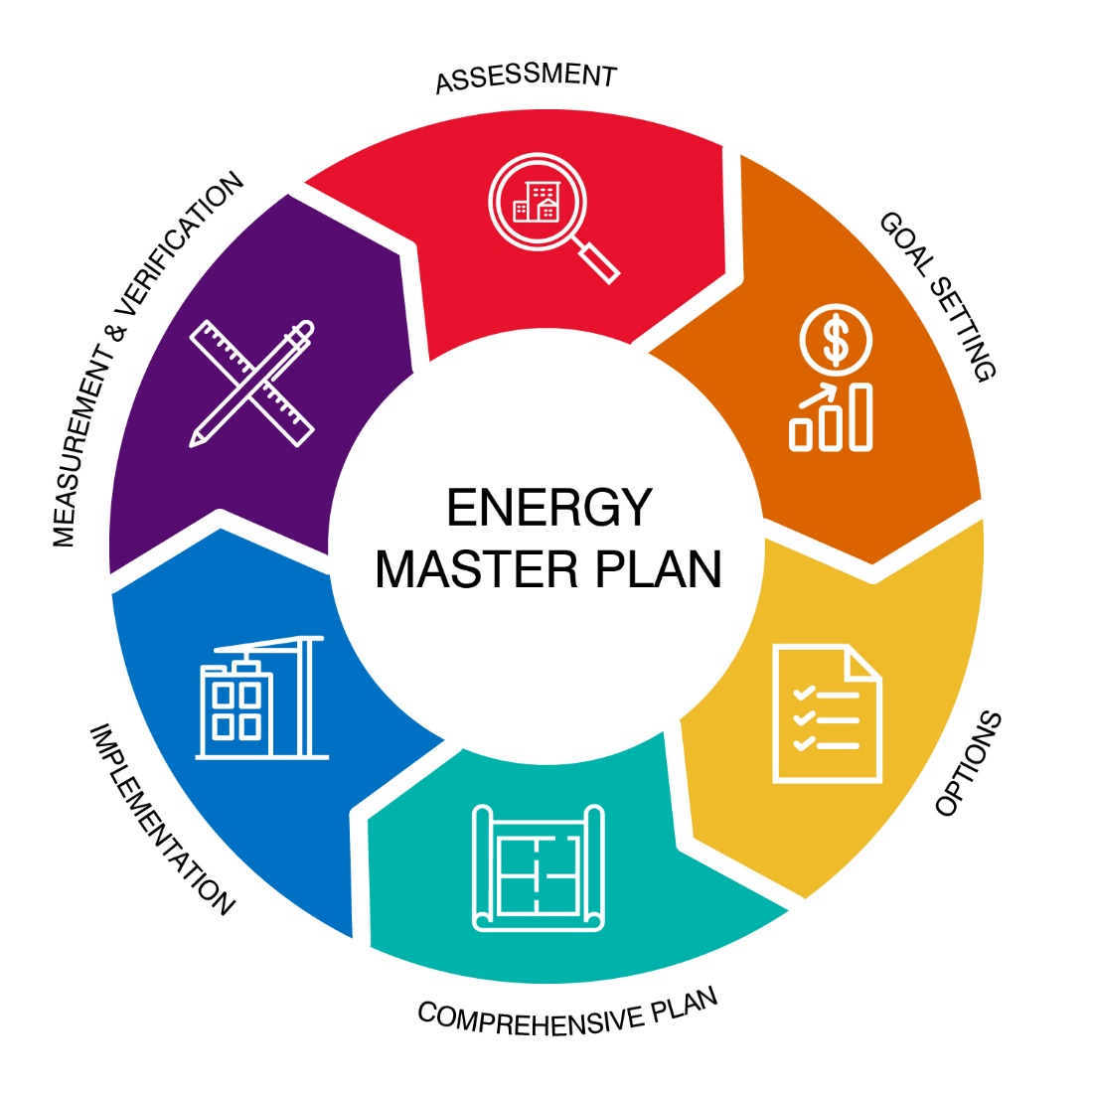
CU ANSCHUTZ – Energy Master Plan (EMP)
The University of Colorado | Anschutz Medical Campus ENERGY MASTER PLAN, when fully implemented, will provide the university with a financially sustainable energy program; providing specific guidance in achieving State legislated energy goals, reducing GHG emissions, EUI and potable water usage, while opening a path to full energy sustainability over time through the greening of the campus electricity supply.
What is “EUI”?
EUI, or Energy Use Intensity, expresses a building’s energy use as a function of its size. EUI is expressed as energy per square foot per year.
Notes:
Jay

Slide 13
Climate Action Plan Update
CLIMATE ACTION PLAN:
a strategic framework for measuring, planning, and reducing greenhouse gas (GHG) emissions and related climatic impacts. (i.e. energy and water consumption, waste diversion, transportation, etc.)
Climate action plans, at a minimum, include an inventory of existing emissions, reduction goals or targets, and analyzed and prioritized reduction actions. Ideally, a climate action plan also includes an implementation strategy that identifies required resources and funding mechanisms.
What is “EUI”?
EUI, or Energy Use Intensity, expresses a building’s energy use as a function of its size. EUI is expressed as energy per square foot per year.
Notes:
Jay

Slide 14
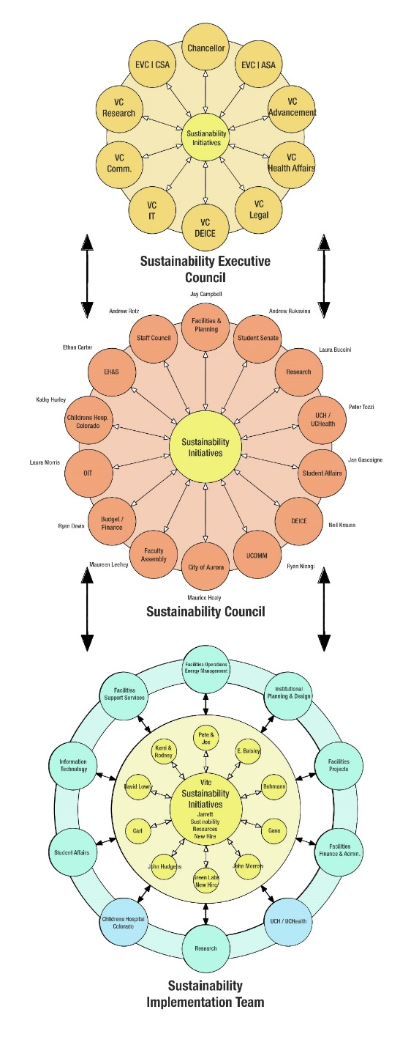
SUSTAINABILITY COUNCIL STRUCTURE
Notes:
Jay

Slide 15
SUSTAINABILITY COUNCIL STRUCTURE
Notes:
Jay

Slide 16
SUSTAINABILITY COUNCIL STRUCTURE
Notes:
Jay

Slide 17
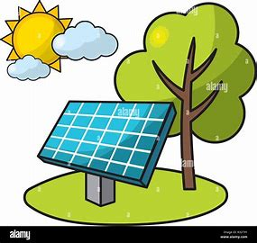
Sustainability Council
How We Build
How We Operate
How We Maintain
How We Power
Notes:
Jay

Slide 18
Sustainability Council
Build
How We Communicate & Educate
Operate
Maintain
Power
Notes:
Jay

