Slide 1
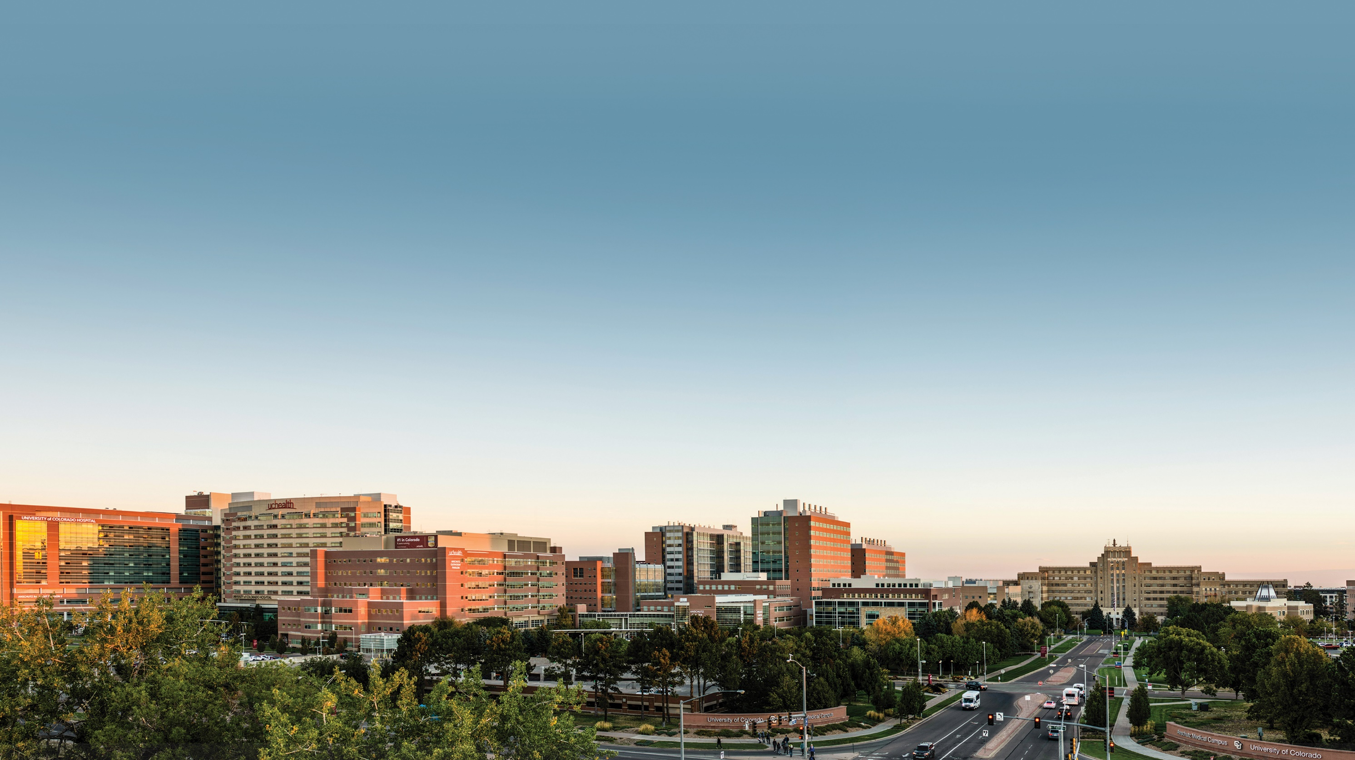

Thomas Flaig, MD
Vice Chancellor for Research
December 7, 2021

Slide 2
PROGRESS THROUGH COLLABORATION
Agenda
Welcome
Central Research Administration
Research Metrics at CU Anschutz
Sponsored Research Funding
The Richness of our Research Community
Special Projects and Future Plans
Questions
Notes:
Separate CU Denver Research Address anticipated

Slide 3

CENTRAL RESEARCH ADMINISTRATION

Slide 4

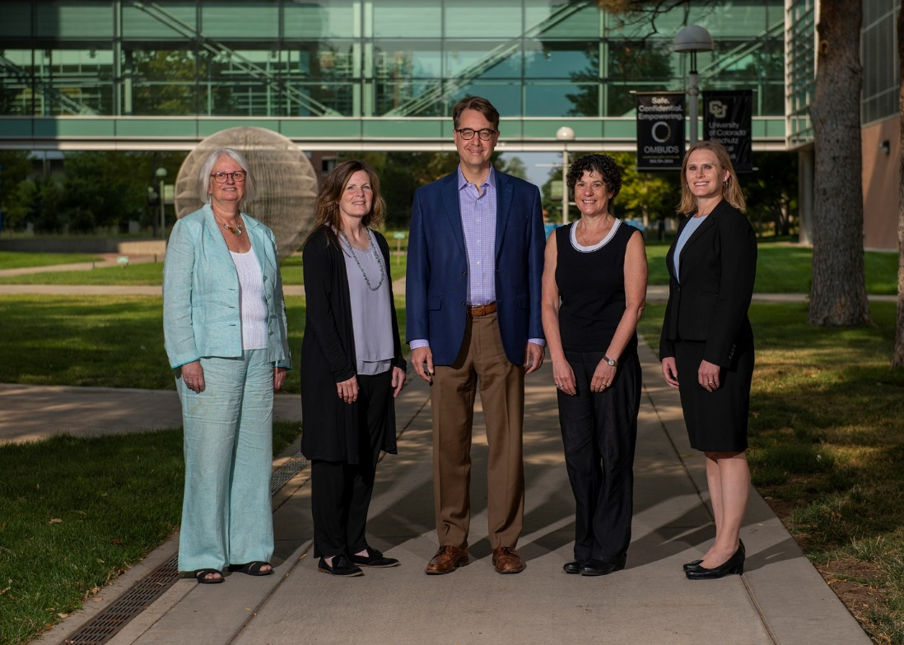
OFFICE OF THE VICE CHANCELLOR FOR RESEARCH CENTRAL ADMIN ORGANIZATION
Alison Lakin, PhD
Lori Sussel, PhD
Associate Vice Chancellor
Regulatory Compliance
Associate Vice Chancellor, Basic Sciences
Amy Gannon
via EVCAF
Jori Leszczynski, DVM
Associate Vice Chancellor, Controller Financial services, Bursar and Grants and Contracts (OGC)
Assistant Vice Chancellor
Laboratory Animal Research (OLAR)
Notes:
Office of Regulatory Compliance
CRSC
COMIRB
COI
Privacy – Ethics & Compliance
EHS
IACUC
Research IT

Slide 5

OFFICE OF THE VICE CHANCELLOR FOR RESEARCH
CENTRAL ADMIN ORGANIZATION
Vice Chancellor for Research
Clinical Research Operations
Laboratory Animal Resources
Reg & Compliance Administration
Basic Science Research Support
Chief Research Informatics Office
CCTSI
Central Administration Support
Regulations and infrastructure
University Research
Foundation of CU Anschutz Research
Notes:
Office of Regulatory Compliance
CRSC
COMIRB
COI
Privacy – Ethics & Compliance
EHS
IACUC
Research IT
Research Consent IRB/FDA
Research COI
Research Billing Coverage Analysis
Privacy Board
Data sharing/Database Security
Research Training, RCR, Research Procedure
IBC, RODC
Investigational Pharmacy, storage management, dispensing
Device Management

Slide 6
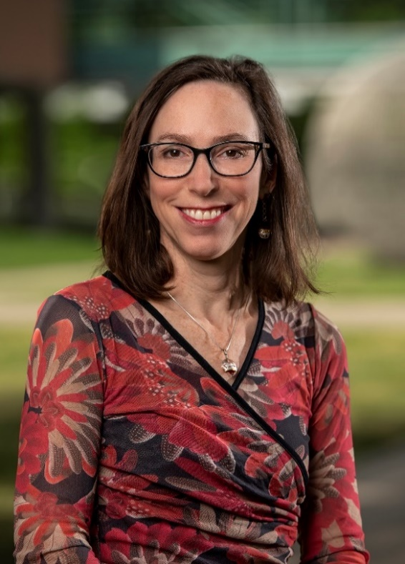
OFFICE OF THE VICE CHANCELLOR FOR RESEARCH
CENTRAL ADMIN ORGANIZATION
Inaugural Chief Research Informatics Officer
Faculty – Center for Health Artificial Intelligence
Recruited by School of Medicine
Internationally recognized research leader
Research Projects:
  Post-Acute Sequelae of COVID-19 (PASC)
  National COVID Cohort Collaborative (N3C)
  National Human Genome Research Institute (NHGRI)
  Reaching COVID to Enhance Recovery (RECOVER)
  National Cancer Institute (NCI) Center for Cancer Data Harmonization
  National Human Genome Research Institute (NHGRI)
Melissa Haendel, PhD
Chief Research Informatics Officer
Notes:
Office of Regulatory Compliance
CRSC
COMIRB
COI
Privacy – Ethics & Compliance
EHS
IACUC
Research IT

Slide 7

RESEARCH
METRICS

Slide 8

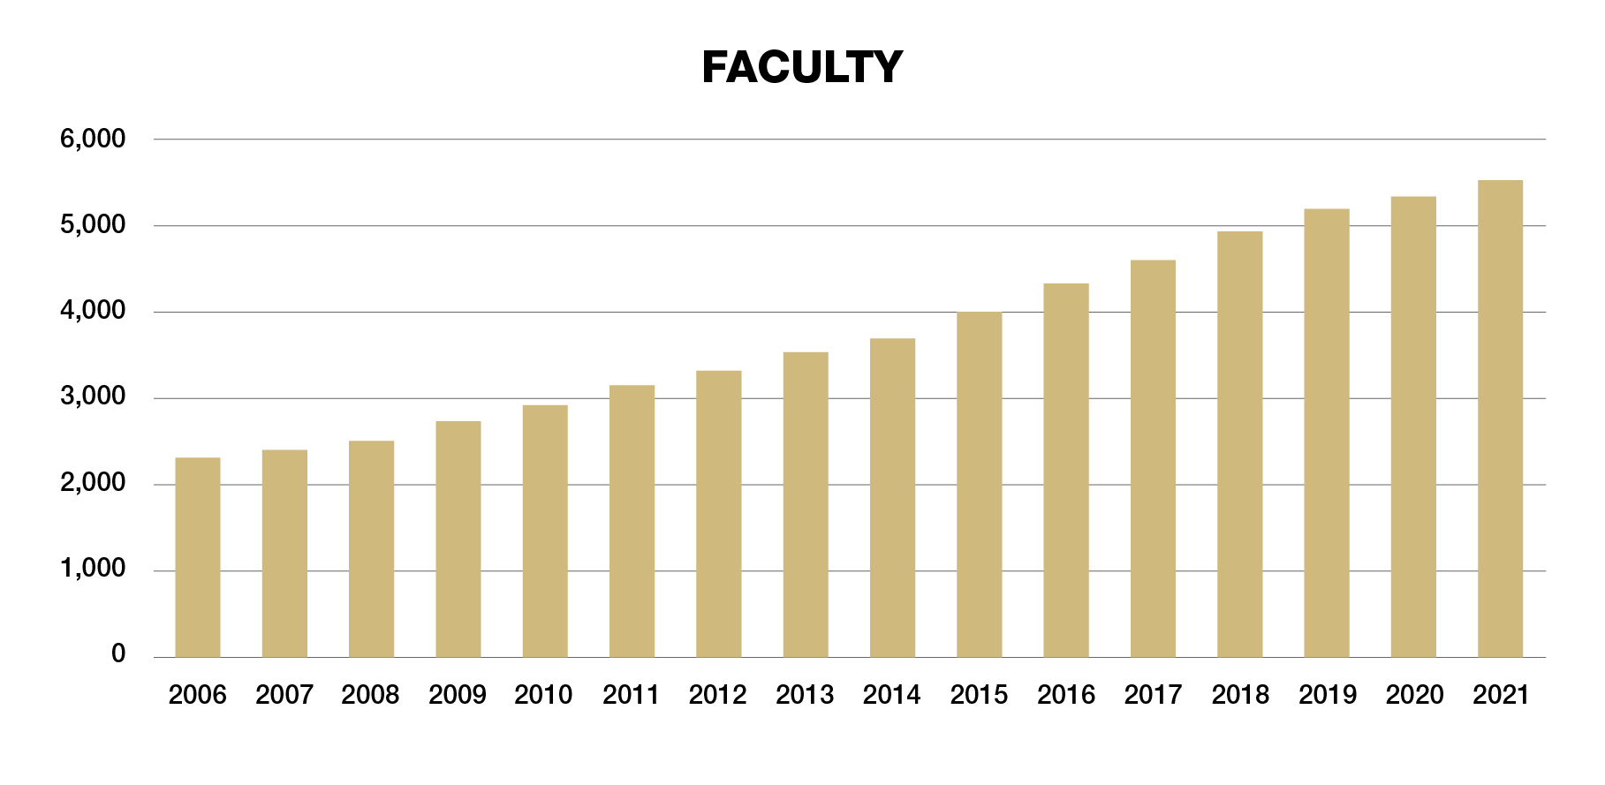
ONGOING PERSONNEL GROWTH
Staff increased from 2,350 to 4,287 in the same amount of time

Slide 9



GRANTS AND CONTRACTS
Supporting Research
3,555
1,799
874
proposals/grants
research contracts from other entities
subcontracts to
other entities
13+ per business day
Notes:
CHANE TITLE TO GRANTS AND CONTTRACTS – ok done
1799 Research Contracts Received
874 Outgoing subcontracts
88,000 emails in Xenia
6373 Active Research Projects
Over 8,700 Sponsor Bills (does not include direct federal LOC draws)
Research Awards in FY2021 - $654M
Not sure he wants --
483 Incoming Fee for Service Contracts (Auxiliaries /core labs, etc.)

Slide 10




CLINICAL RESEARCH
2,709 human subject protocols 3,078 exempt protocols
29,149 help desk tickets
91 INDs
33 sINDs
IND = investigational new drug application
1,827 training attendees
Notes:
Slide 1 Clinical research data:
1-# human subject (HS) protocols 2709 (additionally – Person icon 3078 in ‘approved, not expiring status)- Exempt for HS approval ie, biospecimen, etc
2-# locally held IND/IDEs 91 Tablet or injection icon additionally 33 sINDs/IDEs (IDEs not nee
3-# helpdesk support tickets last fiscal year 29, 149 person/phone icon
# audits: 14
4- # participants in training 1827 book/edu icon

Slide 11
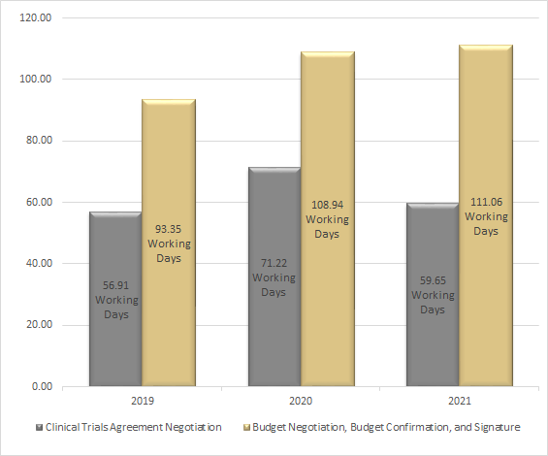
TRIAL NEGOTIATIONS
COVID protocol timeline:
4 days – 31 days to activation
Volume: Clinical Trial data FY20-21
943 CDAs
222 CTAs
Notes:
QUESTION – IS THIS ONLY INDUSTRY TRIALS FOR VOLUME DATA AND CTA’S
Alison: Yes, this data if for clinical trial contracts negotiated by CRAO.
Centralization of budget (budget lives with research team) If we want to get to under 90 days is to better align budget negotiation with contracting.
The gray is what we control and the gold we do not.

Slide 12




BASIC SCIENCE RESEARCH
Material Transfer
Agreements
416 agreements
US, non-profit 7 days;
non-US transfers 20 days;
corporate transfers 40 days
IACUC
529 approved protocols
35 to 40 days to approval
Institutional Biosafety
Committee
482 lab and 53 clinical protocols
30 to 35 days to approval
Rad Safety (HuCIR)
9 active licenses
3 inactive licenses
14 days to approval
Notes:
ICON for
MTAs, volume & review time underneath (Cody to send timeline
Anticipated timelines: US, non-profit & transfers 1 week; for non-US transfers 20 business days; for corporate transfers 40 business days)
IACUC (fish) volume & review time underneath 529 IACUC approved protocols ; 35 to 40 days to aproval.
IBC (germ or bacteria) volume & review time underneath 482 IBC approved laboratory protocols and 53 IBC approved clinical trials; average to approval 30 to 35 days for review time
Rad Safety (hazmat) volume & review time underneath 9 active licenses, 3 inactive licenses
Average time from review to approval is14 days
#MTAs 416 (Document)
# IACUC protocols
# IBC protocols - IBC protocol reviews: 285 total protocols, of which 21 were HGT projects
# Rad safety protocols

Slide 13



OLAR
ABSL2+ and ABSL3:
200% increase
Irradiator in R2 Vivarium:
PRECISION X-Ray Irradiator installed December 2021
Aquatics Infrastructure
2,255 sq. ft 220% increase
Notes:
New/different icons?
Program Accomplishments
• Received Continuing Full AAALAC Accreditation in Summer 2021 after spring site visit. Have been continuously accredited since 1973, USDA licensed and PHS Assured
Expanding animal program space to open in early 2022 which will add ~30,000 sq. ft to expand resources for ABSL2+/3, zebrafish research, behavior research, cardiovascular pulmonary core, hemodynamics core, and provide additional housing space.
• Serves over 300 Principal Investigators and over 2000 research staff in over 100,000 sq feet of
program space on the Anschutz Medical Campus, CU Denver Auraria Campus and Denver Health Hospital
• Average daily census ~24,000 cages caring for over 13 different species
• Serves as a resource for investigators with model development, breeding and technical support,
surgical support, and veterinary care
Zebrafish:
Sq. Footage before = 1,029 sq. ft
820 sf for animal housing, 185 sf procedure space, 24 sf quarantine (+ additional support space for filtration and feeding)
Sq Footage new = 2,255 sq. ft (220% increase)
1550 sf for animal housing, 570 sf procedure space, 135 sf quarantine (+additional support space for filtration and feeding)
Previous #of Rows = 200 (40 racks - all 5 shelf)
New # of Rows = 216 (36 racks – all 6 shelf) – 108% increase in capacity.
For zebrafish there are a variety of tank sizes so we count rows rather than tanks as a measure of capacity.
Other Improvements in Zebrafish area
Space for injection stations before = 4
Injection stations new = 12 (300% increase)
Includes compressed air ports versus tank source and an area to perform fluorescence microscopy rather than darkening entire space
Quarantine Capacity before = 5 rows
Quarantine capacity now = 15 rows (300% increase)
More biosecurity since quarantine is a separate, self-contained room versus previous design where quarantine rack was in the procedure room.
New section served by separate filtration system.
Allows redundancy so if one system goes down, fish can be moved to other system so that there is not a loss of the entire colony.
ABSL2+ and ABSL3:
Current ABSL2+ Capacity: either 420 or 840 (depends on how counted)
420 cage in dedicated ABSL2+ combined with converted regular housing room ~420 additional cages
This is nuanced. We worked with Biosafety Office to open a regular housing room where low level ABSL2 pathogens could be used. This room added an additional 420 cage slots, but due to the restriction on what can be housed in the room and that there are only 2 hoods, we average about 150 cages.
Procedures and equipment are within the housing rooms. Procedures can be performed in housing rooms where only 1 hood is available (except converted room where there are 2). Most BSCs are 4’
New ABSL2+ Capacity: 1680 cages
400 % increase over dedicated ABSL2+ (200% increase when include converted space)
Increase in procedure space available to work and increased functionality of space.
All spaces with 6’ BSCs to include housing rooms, attached procedure room for each housing room, and hallway procedure rooms
1 large room with 2 side-by-side hoods
Old Animal Imaging Core IVIS will be moved to ABSL2+
Current ABSL 3 Capacity: 123 cages in 2 housing rooms
Procedures performed in space where animals are housed.
New ABSL 3 Capacity (when approved): 282 cages (~230% increase)
Create 2 procedure spaces, each with 6’ BSCs
2 swing spaces for future large equipment
X-Ray Irradiator in R2 vivarium
Old Irradiator: RS2000
Installed in 2010 purchased by combined effort of VCR and several PIs.
Reached the end of its usable life.
New Irradiator: PRECISION X-Ray Irradiator
Fully integrated cabinet capable of up to 350kVpat 4kW
Highest delivered dose per min on the market currently and largest diameter/field of irradiation
Purchased with a combined effort: Depreciation (core capital reserves), oVCR funds, and R2 shell space construction funds.
Scheduled to be installed December 7, 2021
** Irradiation in R2 will not be available the week of December 6

Slide 14


SPONSORED
RESEARCH FUNDING

Slide 15


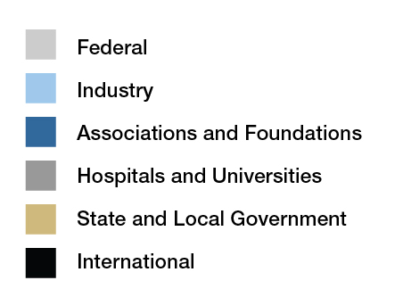
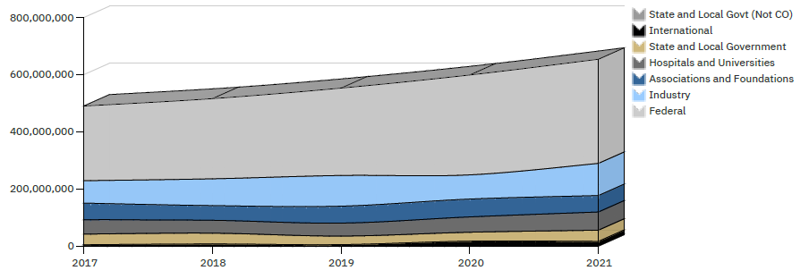
SPONSORED AWARDS
Awards by Sponsor Type
$364.7M
$112.5M
$57.3M
$63.7M
$39.2M
$14.4M
Notes:
CHANGE TITLE TO SPONSORED AWARDS – ok updated
599 TO 654 (confirmed)
CAN WE GET THE SUMMARY FOR FUNDING AGAIN FROM AMY? Yes – we have it, I will email it to you.

Slide 16
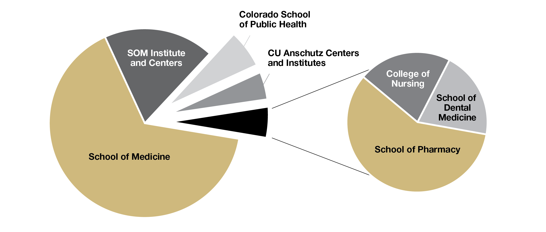
CAMPUS FUNDING CONTRIBUTIONS
Notes:
Updated graphic
TOTAL = $654.2 M

Slide 17
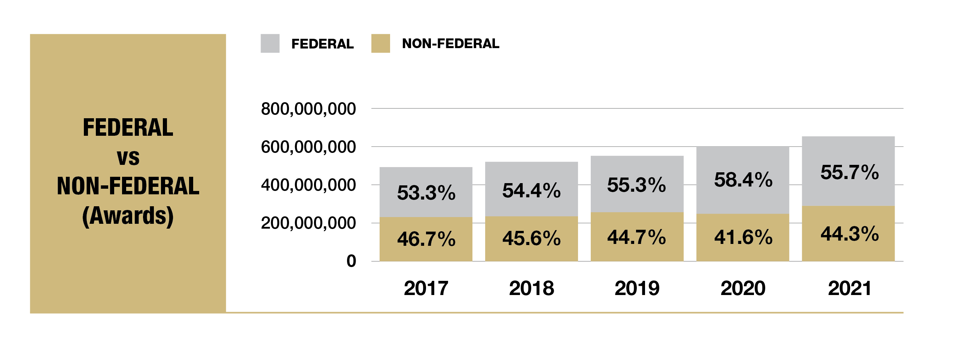
OFFICE OF GRANTS & CONTRACTS
Notes:
CONFIRM WITH AMY – 599 TO 654
Ok, confirmed

Slide 18
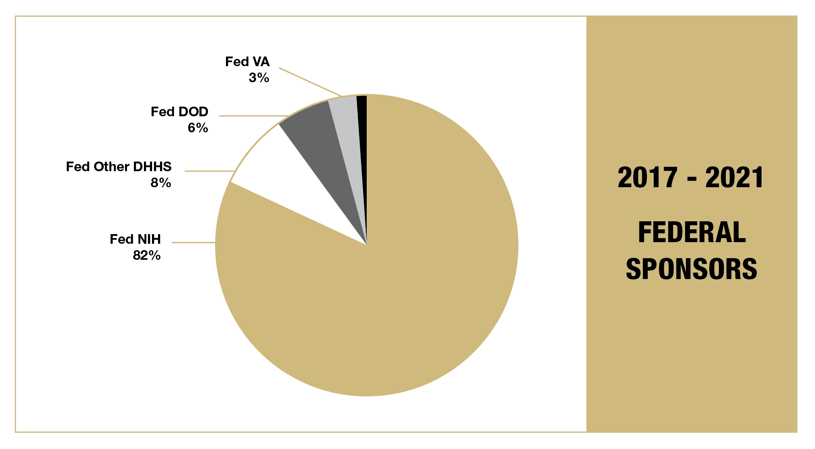
OFFICE OF GRANTS & CONTRACTS
Notes:
NSF included in the 1% ($15.2M)
Small black sliver =
Fed NSF: 15,288,252 = 0.54%
Fed Other: 6,351,279 = 0.23%

Slide 19


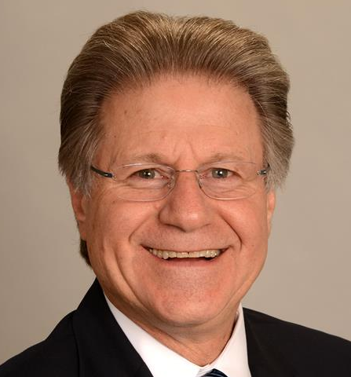

CCTSI SUPPORTING COVID
mAb Colorado
  CCTSI leads a statewide study to provide monoclonal antibody treatment across Colorado, with outreach to underrepresented groups. PI: Adit Ginde, MD, MPH
RECOVER Grant
  CCTSI is part of a major NIH initiative to identify the causes and optimal treatment of Long COVID. PIs: Kristine Erlandson, MD, Ronald Sokol, MD, and Connie Price, MD (Denver Health)
Colorado COVID-19 Community Engagement Alliance (CEAL)
  CCTSI’s CO-CEAL is a partnership between the university and community-based organizations to improve community engagement and outreach. The effort will build community partnerships to improve diversity and inclusion in COVID-19 research. PIs: Don Nease, MD, Ricardo Gonzalez-Fisher, MD, and Ronald Sokol, MD
Ron Sokol, MD
Assistant Vice Chancellor for Clinical and Translational Science
Director, Colorado Clinical and Translational Sciences Institute
Notes:
A LITTLE BUSY SLIDE
Colorado Clinical and Translational Sciences Institute (CCTSI) is a jewel in the research infrastructure of campus – and a shining of example of how our university is leading research to improve and save lives, especially during the pandemic.
CCTSI leads a statewide study to provide monoclonal antibody treatment across Colorado, reach underrepresented groups hardest hit by COVID, and study dissemination & implementation techniques for future efforts. PI: Adit Ginde, MD, MPH
RECOVER Grant
CCTSI is part of a major NIH initiative to identify the causes and optimally treatment of Long COVID. PIs: Kristine Erlandson, MD, Ronald Sokol, MD, and Connie Price, MD (Denver Health)
Colorado COVID-19 Community Engagement Alliance (CEAL)
CCTSI’s CO-CEAL is a partnership between the university and community-based organizations to provide trustworthy information through community engagement and outreach to those hardest-hit by the pandemic. The effort will build community partnerships to improve diversity and inclusion in COVID-19 research for new treatments, vaccines, and other virus prevention practices. PIs: Don Nease, MD, Ricardo Gonzalez-Fisher, MD, and Ronald Sokol, MD

Slide 20

THE RICHNESS OF OUR
RESEARCH COMMUNITY
Progress Through Collaboration

Slide 21

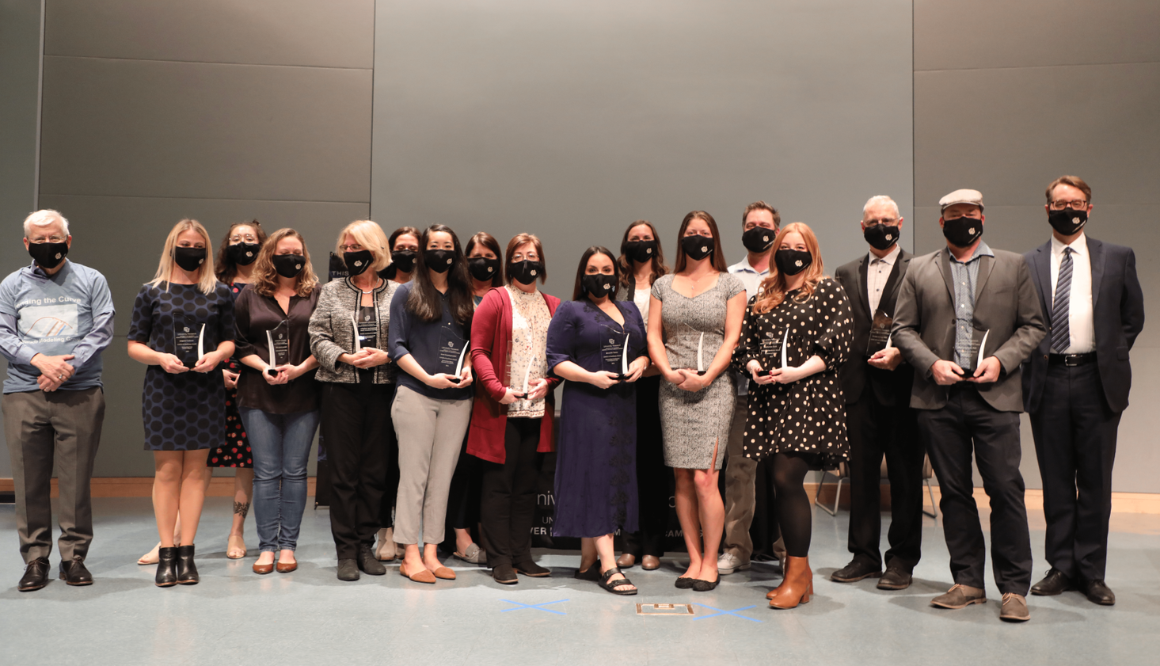
UNIVERSITY RESEARCH AWARDS CEREMONY
9 Award Categories
126 Nominations
17 Award Recipients

Slide 22
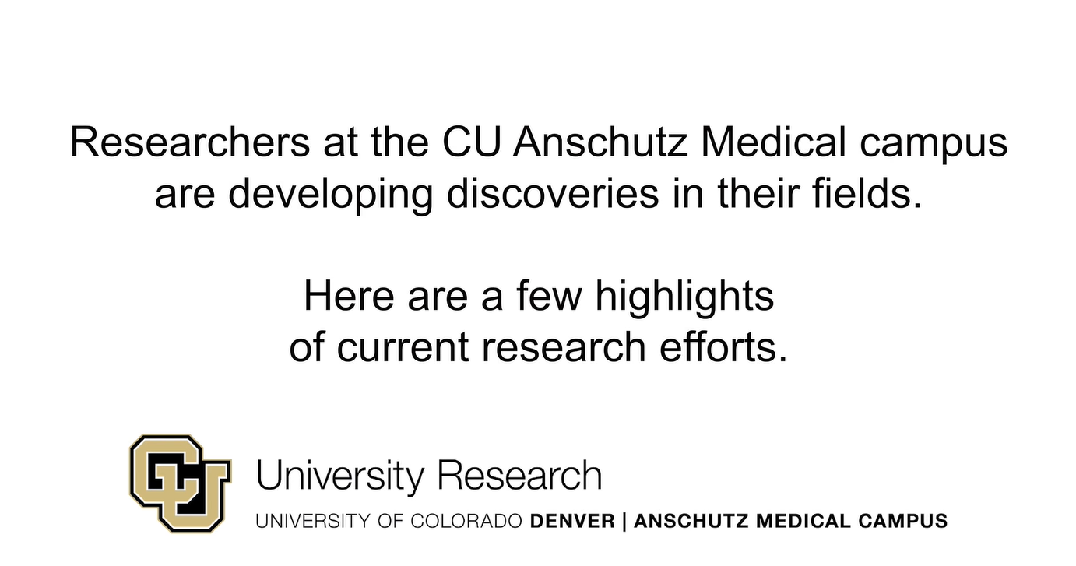
VIDEO
Click Here
Notes:
This is a compilation of several interviews from researchers on campus
There is lots of COVID 19 research taking place in this campus.
The impact of COVID-19 on the CU Anschutz Medical Campus has been significant. Our researchers have been working and collaborating, campuswide, nationally & internationally to address this pandemic. We talked to a few researchers about their involvement in their contributions to the COVID research effort.
COVID-19 has impacted us all. Researchers at the CU Anschutz Medical Campus have been working countless hours responding to this global pandemic. These are just a few examples of researchers collaborating and doing what we do best. Research!

Slide 23
NEW LEADERS ON CAMPUS
Chief Research Informatics Office
Center for Health Artificial Intelligence
Office of Information Technology
Health Data Compass
Healthcare Innovation Institute
Notes:
WATCH THE CHANCELLORS TALK AND HOW HE DISCUSS THE INSTITUTE – look at printed script
This is a compilation of several interviews from researchers on campus
There is lots of COVID 19 research taking place in this campus.
The impact of COVID-19 on the CU Anschutz Medical Campus has been significant. Our researchers have been working and collaborating, campuswide, nationally & internationally to address this pandemic. We talked to a few researchers about their involvement in their contributions to the COVID research effort.
COVID-19 has impacted us all. Researchers at the CU Anschutz Medical Campus have been working countless hours responding to this global pandemic. These are just a few examples of researchers collaborating and doing what we do best. Research!

Slide 24

SPECIAL PROJECTS
AND FUTURE PLANS

Slide 25

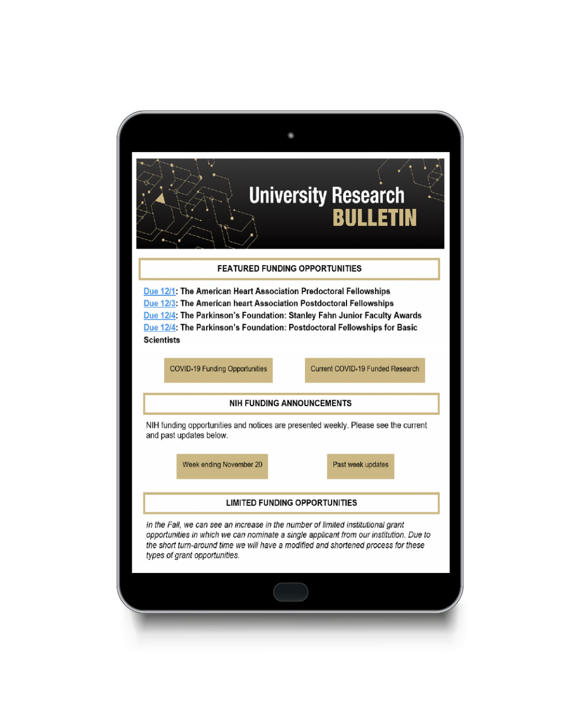
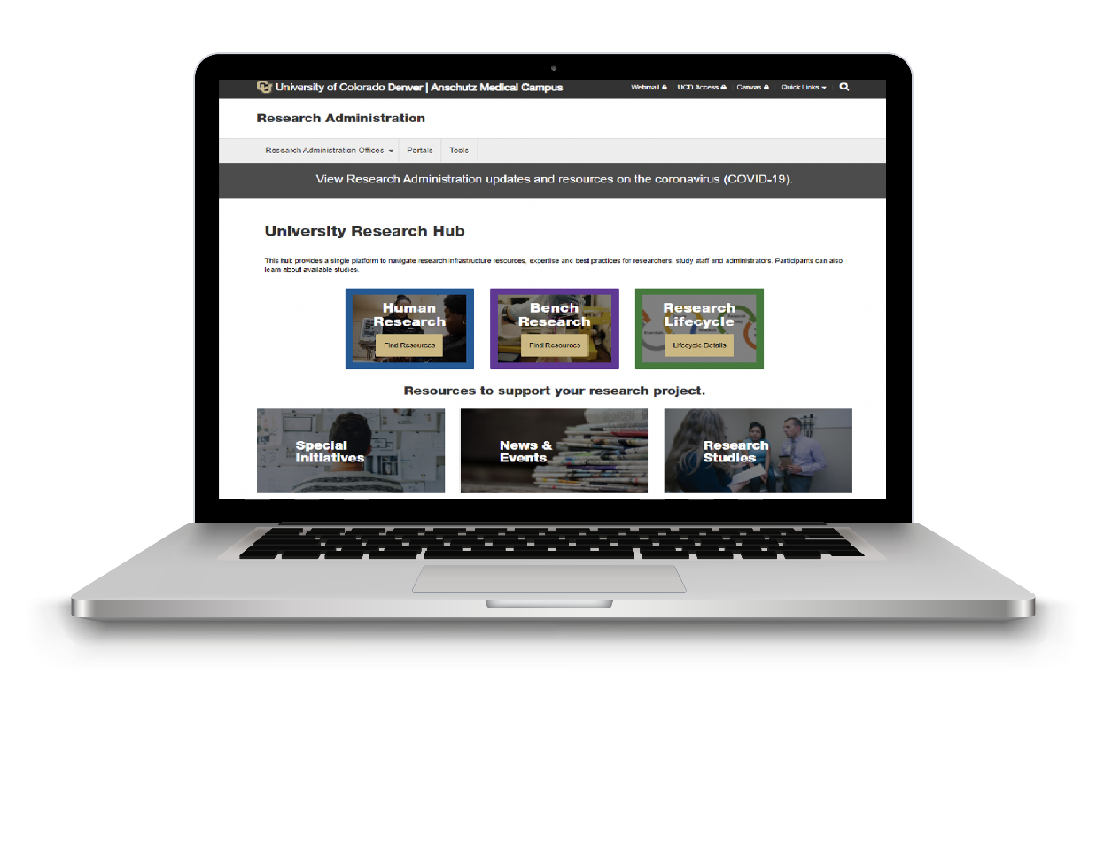
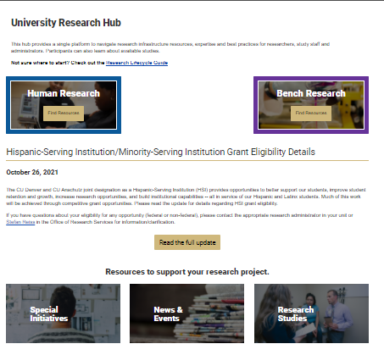
RESEARCH COMMUNICATIONS
Research Bulletin launched in May 2020
  37+ issues
  13K+ recipients per issue
Vice Chancellor Communiques
www.research.cuanschutz.edu
ResearchAdminComm@cuanschutz.edu
Notes:
IS THE BULLETIN ON THE 1 AND 3 TUESDAY OF EACH MONTH? Yes, confirmed by NP
Vice Chancellor communiques (tapered off in spring 2021)
Town Halls
University Research Website

Slide 26

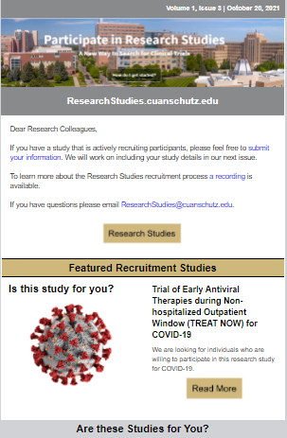
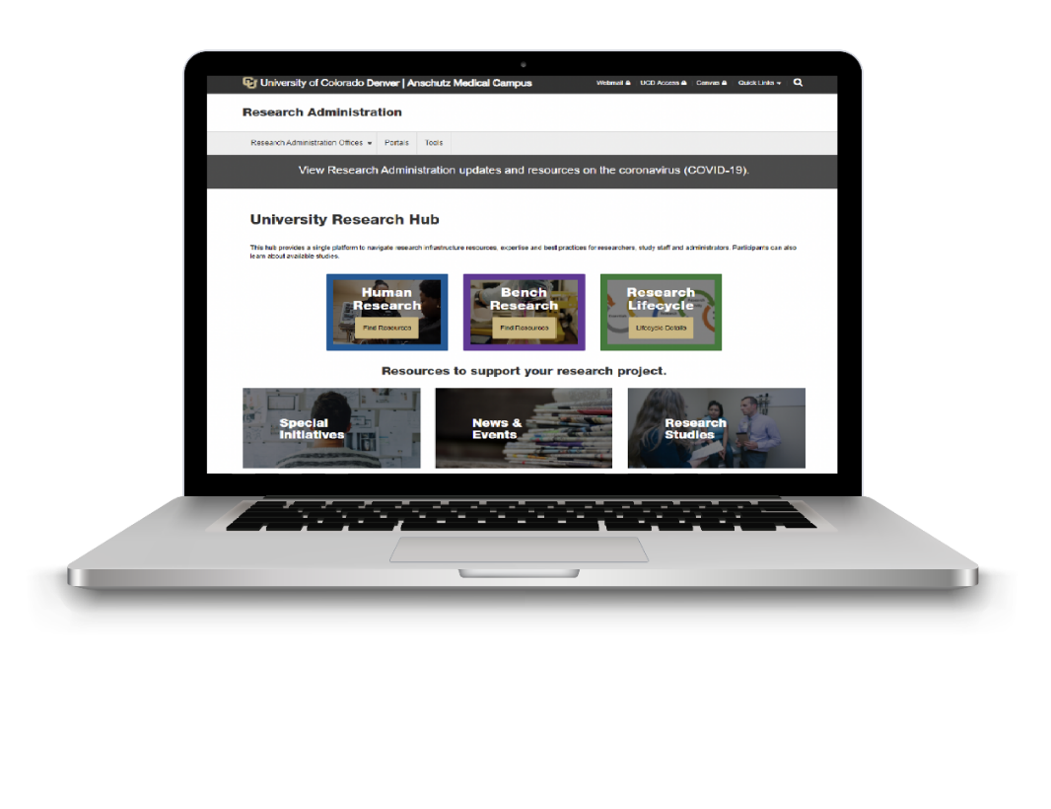
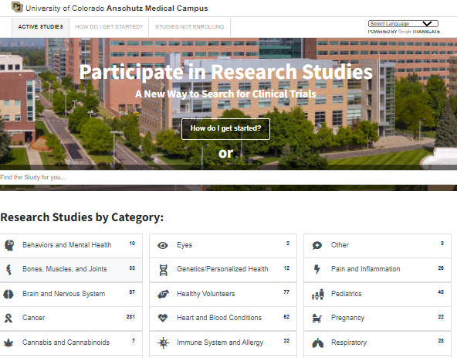
RESEARCH STUDIES
ResearchStudies.cuanschutz.edu launched 2020
Quarterly lunch & learns
Weekly office hours
Research Studies newsletter launched September 2021
Reduces list serve activity
ResearchStudies@cuanschutz.edu
Notes:
Research Studies newsletter launched September 2021
13K+ recipients per issue
25%+ open rate

Slide 27

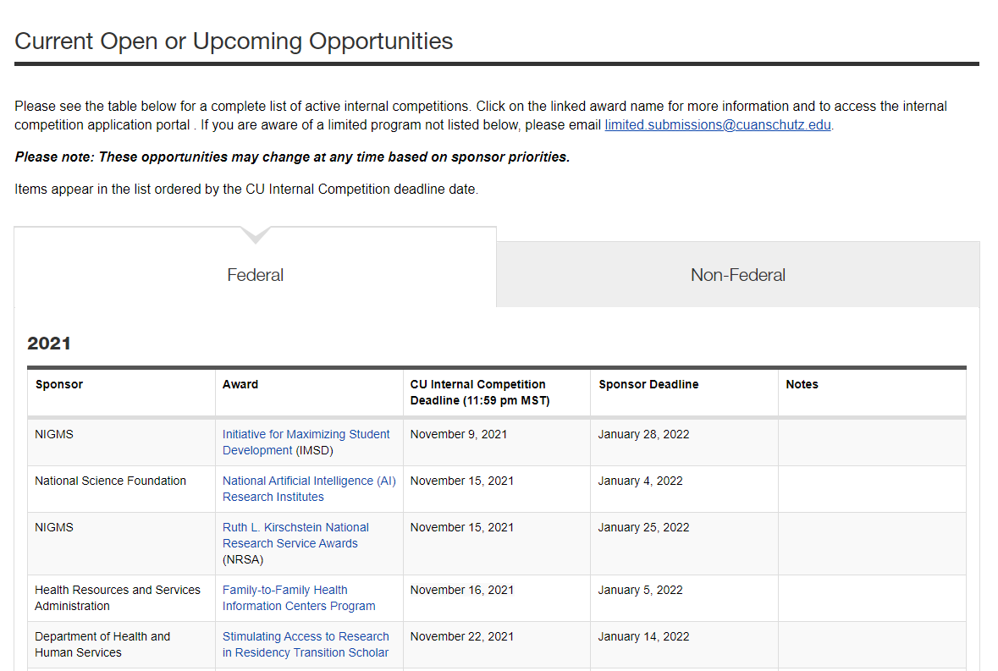
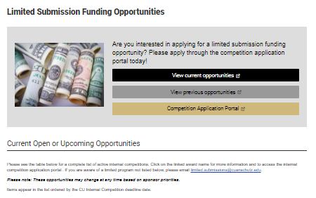
LIMITED INSTITUTIONAL GRANTS
Limited Submissions Funding Opportunities
Notes:
Amy
Lori

Slide 28
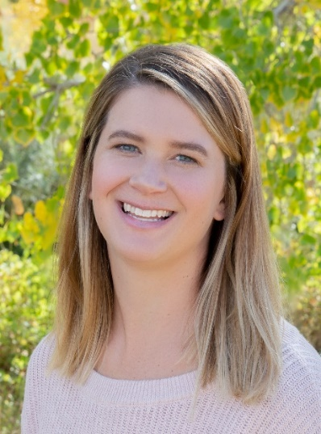
AB NEXUS PROGRAM
PROGRAM ADMINISTRATION
  Commitment of Funds
      President’s Initiative; CU Anschutz, CU Boulder, CU System
      $3M total commitment over 3 years (FY 2021, FY 2022, FY 2023)
  Administrative Process Improvements
    Master Collaboration Agreement executed
      Expedited joint proposal review
      Reduced form requirements
      No additional F&A on first $25k of direct costs on intercampus subcontracts
Diane M. Ladell, MPH
Research Development Partnership Specialist
AB Nexus www.cu.edu/ab-nexus

Slide 29
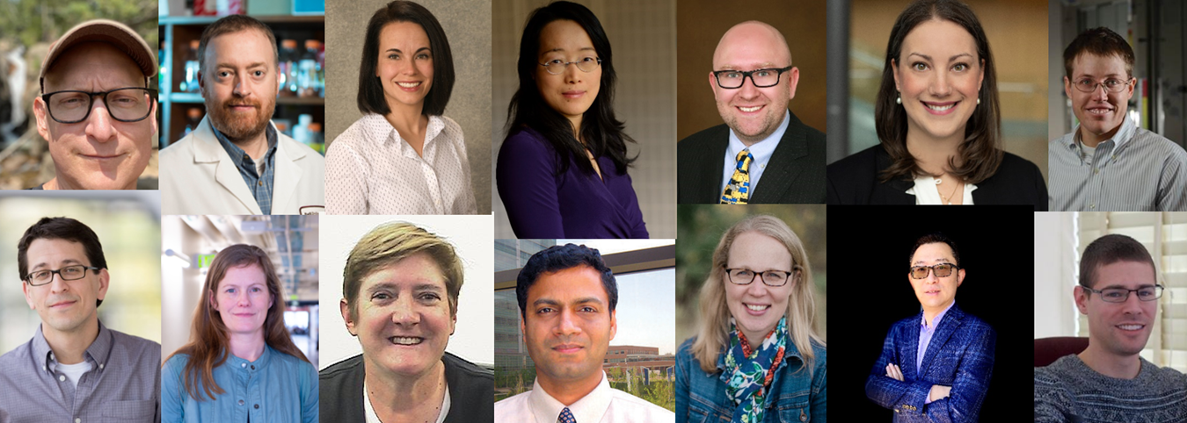
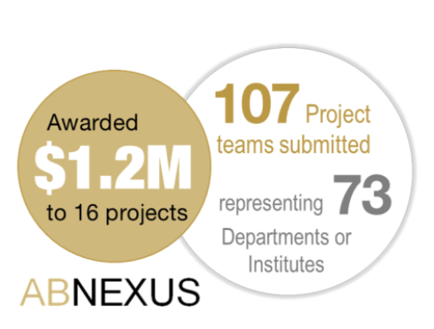
AB NEXUS GRANT PROGRAM
FY22: Congrats Fall 2021 Award Winners!
FY21: Summary
FY22: Next Round is Spring 2022

Slide 30
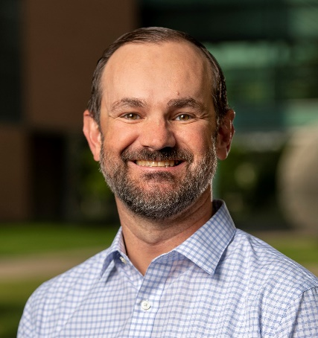
CLINICAL RESEARCH SUPPORT TEAM (CReST)
CReST was created in 2017 as a CCTSI program to support investigators and clinical research teams. ​
  Currently supports over 130 studies with more than 70 unique investigators in 30 departments across campus.
  Provides fee-for-service regulatory, budget development, trial coordination, monitoring, chart abstraction, and post-award work for clinical trials.
Clinical Research Connections Monthly Forum
  3rd Tuesdays at noon
Aaron Mobley, PhD
Director of CReST
Notes:
As of July, CReST is an institutional resource in the Office of the Vice Chancellor for Research
CAR T trials currently underway in Adults
CAR T – GBF
Treating patients on campus
Support team in VCR office

Slide 31
VIRTUAL CLINICAL TRIALS
  Anticipation of changes in the conduct of clinical trials
      Some of this is technology, some of this is COVID related learning
      The clinical trials of the future will likely be very different
      One goal is to reduce the burden on participants and providers
  Bringing together a working group in this area to explore opportunities on campus
      We have multiple applicable resources and experts on campus
Notes:
Changes in the conduct of clinical trials
Placeholder slide
Add info on VCT…Adit, marc B, Metformin, EPIIC…
TF will provide data

Slide 32


VIRTUAL CLINICAL TRIALS
Collecting data by a patient going to a clinic visit with a study coordinator allows for a lot of consistency and rigor, but it's a very limited slice of human existence. When you start monitoring research participants at home, around the clock, with sensors and a sleep monitor and running a wide array of tests on them, well, that's a whole different view of the human condition.
-Robert Califf, MD
https://www.acc.org/latest-in-cardiology/articles/2021/08/01/12/42/cover-story-clinical-research-in-a-big-data-high-tech-world
Notes:
Changes in the conduct of clinical trials
Placeholder slide
Add info on VCT…Adit, marc B, Metformin, EPIIC…
TF will provide data

Slide 33
COVIDome
Effort led by Joaquin Espinosa, PhD
  https://medschool.cuanschutz.edu/covidome
  COVIDome Explorer used by 1400 + users in 60+ countries
Has led to publications including in Cell Reports
Health Care worker COVID effort in collaboration with Kevin Deane, MD and others
  Elena Hsieh, MD: COVID-19 Risk Factors And Immune Response In Healthcare Workers
Notes:
CHANGED GRAPHIC – LOOK OK? Yes – confirm how to say Elena’s name
Email copied:
1. COVIDome batch 2 has now completed metabolomics, 2 x proteomics (mass spec and SOMAscan), transcriptomics, and about to complete MSD cytokine profiling. These will be great complementary datasets to what Elena and Ross are generating from these same samples.
2. We are on top of the clinical data for batch 2, Matt copied here is working with Seth in Tell’s team and the HDC team to produce this asap.
3. CT Values. We are NOT on top of this. Happy to become part of the dialog, but if Elena and Kevin already have this dialog ongoing with Ian
On the good news front, last time we checked the COVIDome Explorer had been used by 1000+ users around 40+ countries, and the third COVIDome paper has received decent reviews from PNAS, planning to resubmit before the end of the year.
Here are the two published papers from the COVIDome project:
URL: https://pubmed.ncbi.nlm.nih.gov/34348131/
URL: https://pubmed.ncbi.nlm.nih.gov/33724185/
And a third one under review at PNAS:
https://www.medrxiv.org/content/10.1101/2021.07.29.21261325v1

Slide 34
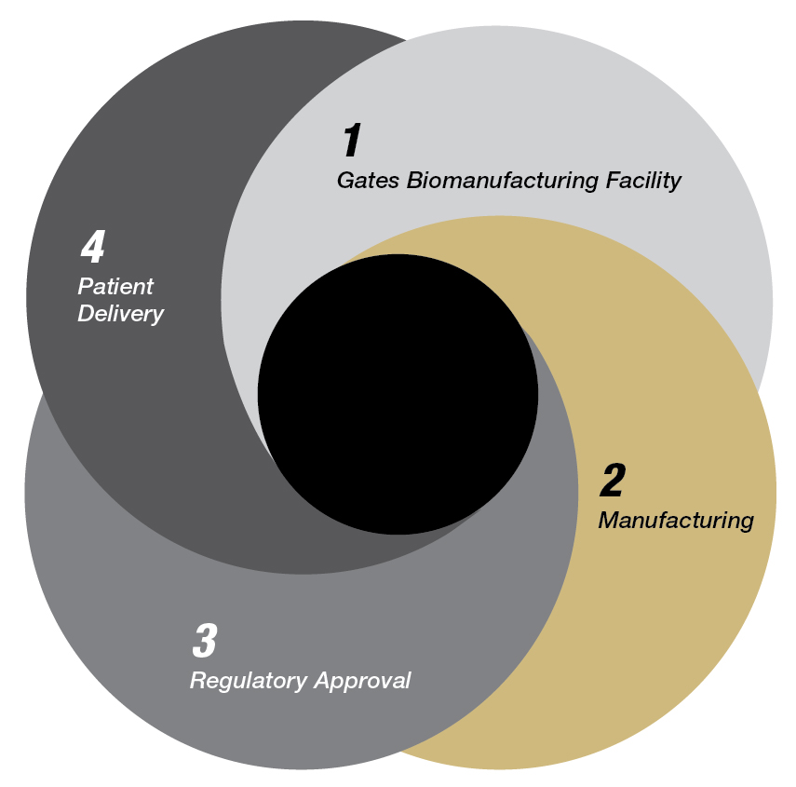
SPONSORED CELL THERAPY TRIALS
A Phase I study of feasibility and safety of UCD19 CAR T Cells in adult patients with B-Cell Non-Hodgkin Lymphoma (B-NHL)
  Site PI: Manali Kamdar, MD
  Currently Enrolling
A Phase I/II study of preliminary efficacy of UCD19 CAR T Cells in pediatric patients with B-Cell Acute Lymphoblastic Leukemia (B-ALL) and B-Cell Non-Hodgkin Lymphoma (B-NHL)
  Site PI: Amy Keating, MD
  Currently Enrolling
A Phase I/Ib study of bispecific UCD19x22 CAR T Cells in adolescent and adult patients with B-Cell Non-Hodgkin Lymphoma (B-NHL)
  Site PI: Manali Kamdar, MD
  Currently Enrolling
  CU Anschutz is the sponsor of these trials, with CTOP managing operations and GBF responsible for manufacturing.
Cell Therapy Developmental Pathway
Notes:
MAY WANT TO PUT A TITLE ON THIS GRAPHIC Cell Therapy Developmental Pathway - Done
GBF: per Matt Seefeldt
Enrolling (and perhaps dosing) the first patient in the UCD19-22 CART program
Continued manufacturing to support the UCD19 trial – the number of runs should be emphasized (should be close to 10 patients by then)
Emphasize that a soup to nuts facility has been built that can take any biologic or cell therapy into a Phase I clinical trial – we are up to 6 IND’s now (100% success rate) since 2018, actively working on 4 additional University of Colorado technologies.\

Slide 35
SPECIAL INITIATIVES – oVCR
Multi-Investigator Grant Advisory & Support Program
  Partnership between the oVCR and SOM to catalyze and facilitate large
  collaborative grant programs
    VCR effort led by Lori Sussel, PhD.
  Includes P30, P50, T32, multi-PI, etc grant mechanisms
  Seed funding to generate preliminary data
  Assistance with assembly and submission proposals to external
  funding agencies
  For more information visit the website or contact Email: vcrgrantsupport@ucdenver.edu
Notes:
ADDED LORI

Slide 36
SPECIAL INITIATIVES – oVCR
Basic Science Outreach: Transforming Health Care Event
  Raise awareness of outstanding basic research endeavors at CU
  Communicate scientific advances to the broader community
  RNA Biology Symposium: April 26, 2022 (open to the public)
  Broad collaborative effort with Chancellor’s office, Communication office, SOM and others.
  Future topics TBD
Notes:
Lori
Kathy Green
Mark Couch
Chancellor

Slide 37
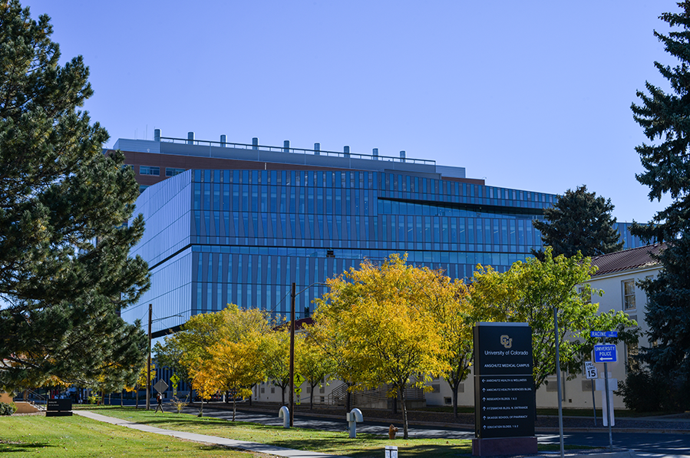
ANSCHUTZ HEALTH SCIENCES BUILDING
CCTSI space: Clinical Translational Research Centers
  New facilities
Investigational drug pharmacy
  Led by the School of Pharmacy
Gathering of Personalized Medicine and Health AI efforts… among many others

Slide 38
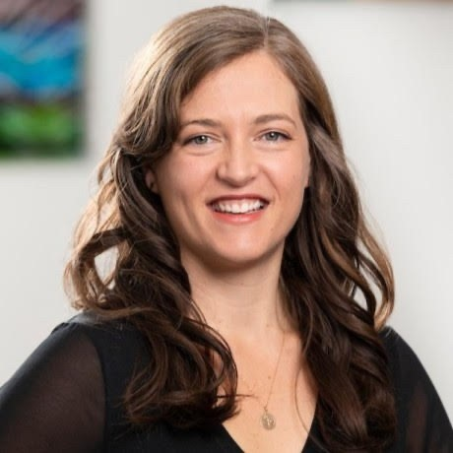
SPECIAL INITIATIVES – oVCR
Continuous Improvement (CI) support
  Project Guidance (initial projects focused on central research operations: research study startup, health data compass, biobank process with pathology shared services)
  Training and Education (partnering with the Office of Learning and Development to offer CI trainings)
  Strategic Support (oVCR Mission, Vision, Values development)
  CI Coaching, ad hoc
Using a structured methodology to guide process improvement work:
Initial Perception of the Problem
Analysis of the Current State using Root Cause Analysis
Definition of Target State
Action Planning, Experimentation, and Measurement
Leah Emerick
Sr. Continuous Improvement Specialist
Office of the Vice Chancellor for Research

Slide 39
FUTURE… WHAT’S NEXT
Progress through collaboration
  Promote intra-campus and inter-campus research
  AB Nexus with CU Boulder – extend further
Promote Diversity, Equity and Inclusion in our research mission
Hispanic-Serving Institution
New efforts led by Lori Sussel, PhD
  Program project/team science work
  Facilitate support for basic science endeavors

Slide 40
FUTURE… WHAT’S NEXT
Support efforts of the CRIO – Melissa Haendel
  CRIO is working on several new initiatives
Virtual clinical trials
  Working group is in place with broader community outreach planned
Research communications
  Will continue to expand and strengthen our internal and external communications
  Working closely with the campus communications team
Ongoing process improvement efforts for our key support functions

Slide 41
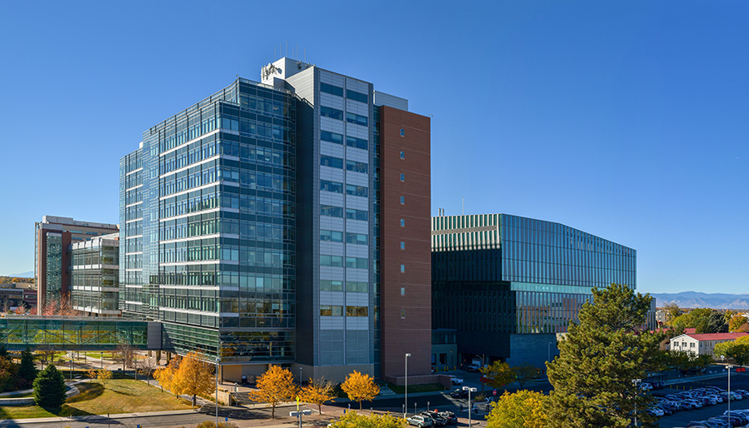
Thank You

