Slide 1
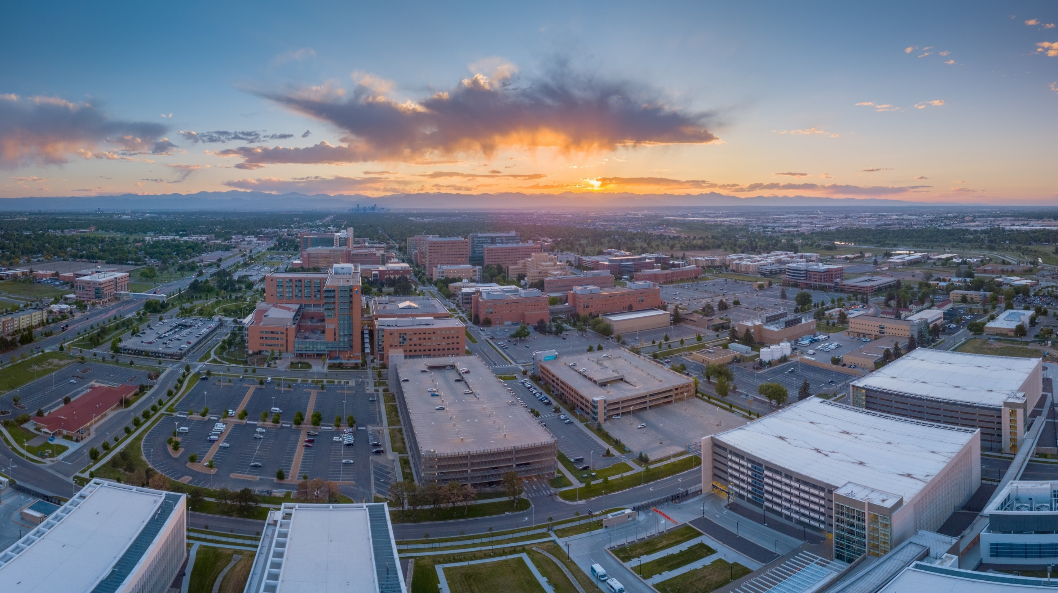
Presidents Round Table
November 2022
Office of Student Engagement
We will start at 12:15pm

Slide 2
PRT Meeting Agenda
Introductions – Poll Everywhere
PRT Introduction
Guest Speaker
Associate Vice Chancellor of Student Affairs
Guest Speaker
Marketing Guidelines by Office of Communications
Organization Announcements

Slide 3
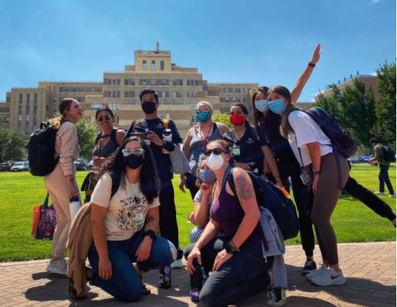
PRT Introduction
Monthly Meetings for all student orgs
February, March, April
Presidents Round Table – PRT
Guest Speakers
Policies/Procedures
Build Community
Learn from each other
Collaborate
Share announcements/events

Slide 4
Guest Speaker
Jan L. Gascoigne. PhD, MCHES Associate Vice Chancellor for Student Affairs Associate Clinical Professor, Community & Behavioral Health - CSPH Jan.Gascoigne@CUAnschutz.edu

Slide 5
Guest Speaker
Kiley Kudrna
Communications Specialist, Office of Communications
kiley.kudrna@cuanschutz.edu
Sarah Adams
Creative Content Designer, Office of Communications
SARAH.L2.ADAMS@CUANSCHUTZ.EDU

Slide 6
Reach all Students
Weekly Monday CU Anschutz Student Newsletter
Submit this form by Wednesday to have announcement in newsletter
https://ucdenverdata.formstack.com/forms/cu_anschutz_student_newsletter_submissions

Slide 7
Social Media
Request Student Affairs to post on your behalf:
If you would like for us to make a post for you, please fill out this form at least one week before we need to post it. Please provide your own image, appropriate instagram post size.
Create New Account:
BEFORE YOU LAUNCH YOUR SOCIAL PLATFORMS and prior to getting started on social, please click here to fill out the registration form.
If you’re unsure if social media is right for your school, department or unit contact the Student Engagement Coordinator. We’re here to help. Contact: studentorganizations@cuanschutz.edu

Slide 8
Flyers
Honor System buildings OR hand them to the appropriate Administrator to get a stamp.
Refer to the building posting list for clarification as to whether an approval stamp is required.
Flyers should be removed by the installer in a timely manner. The posting must be removed either the day of or the day after the event or 30 days from the posting date.
Building posting list can be found on the CU Anschutz student organization building-administrators-listing.pdf (cuanschutz.edu)
Student Org Marketing (cuanschutz.edu)

Slide 9
Marketing
Resources
General Marketing
Student Org Marketing (cuanschutz.edu)
Social Media
Social Media Guidelines | Office of Communications (cuanschutz.edu)
CU logo usage/approval process
CU Anschutz Branding Guidelines

Slide 10
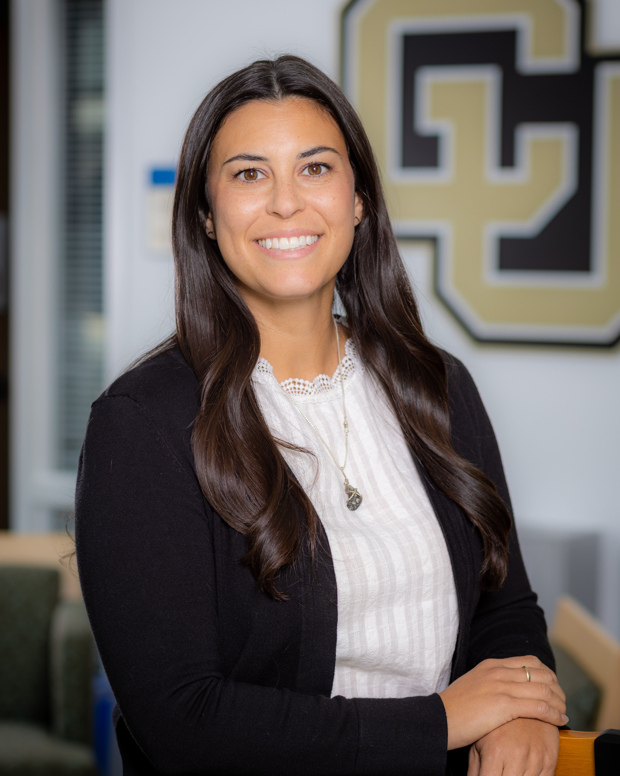
Contact Us
Student Affairs – Office of Student Engagement
Education 2 North, Suite 3200
studentaffairs@cuanschutz.edu – (o) 303.724.2866
Katelyn Martin
Coordinator of Student Engagement – Education 2 North, 3201
Katelyn.martin@cuanschutz.edu – 303.724.4435

