Slide 1
The Anschutz Health
Sciences Building
Construction Update
8 March 2019

Slide 2
Project Leadership and Staff Introductions
Project Overview
Current and Upcoming Activities
R2 Impacts and Mitigation Efforts
Agenda

Slide 3
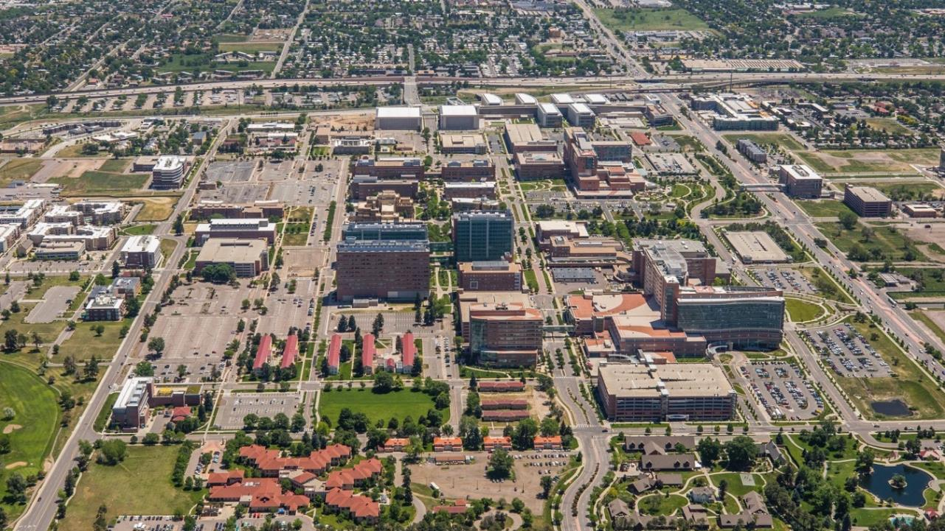
Project Leadership and Staff Introductions

Slide 4
Doug Wilson, Project Director
doug.wilson@caaicon.com
David Turnquist, Associate Vice Chancellor
Facilities Management
Michael Barden, Director
Facilities Projects
Daniel Loosbrock, Project Executive
daniel.loosbrock@caaicon.com
Ethan Carter, PhD, Director
Department of Environmental Health and Safety
Breanne Beck, Senior Industrial Hygienist
Department of Environmental Health and Safety
LoriAnn Smith, Associate Director
University Risk Management

Slide 5
Project Overview

Slide 7
Building Gross Area – 390,391 GSF

Slide 8
Current and Upcoming Activities

Slide 9
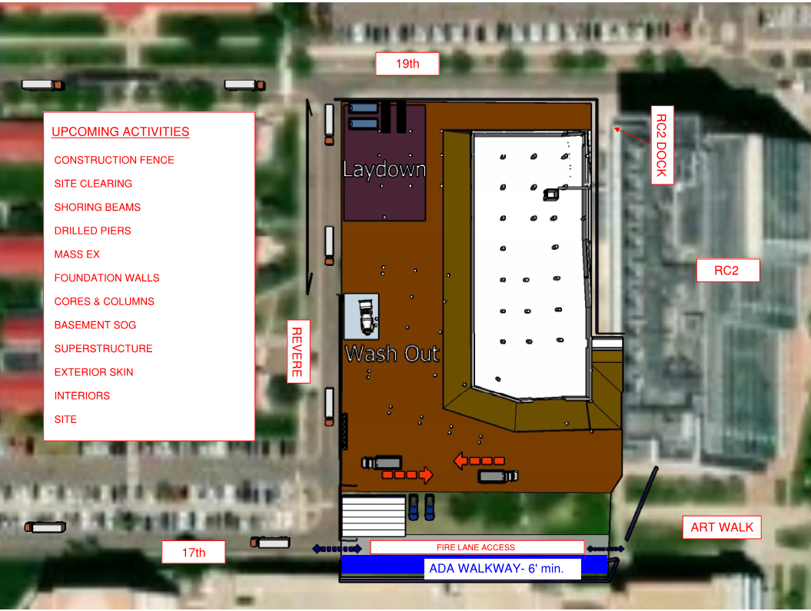

Slide 10
R2 Impacts and Mitigation Efforts

Slide 11
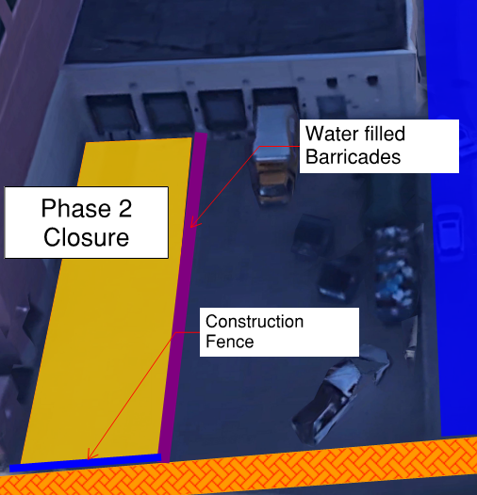
Research Complex 2 Impacts
Air Intake
Mitigation Efforts
Equipment Requirements: Tier 4
Intake Filters
Air Diffuser Filters
Project Monitoring
Intake Monitoring
Space Monitoring
Loading Dock
Phase 1: West two dock openings March 4 – March 8
Phase 2: East two dock openings March 11 – March 14
Utility Impacts
Electrical, Gas, Plumbing etc.
Best Practices
Facilities Management
Customer Service Center: 303-724-1777.
Contact Information
Doug Wilson, doug.wilson@caaicon.com

Slide 12
Air Flow Diagram

